Slide 1

CSA1501-CLOUD COMPUTING
Title
DevOps and CI/CD in Cloud Computing
Supervisor : Dr . BOOMIJA M D
Students :
P. Poorna Chandra (192472287).

Slide 2
INTRODUCTION
What is DevOps?
DevOps is a way of developing software where developers and operations teams work together. Their goal is to build, test, and release software quickly and without errors.
What is CI/CD?
Continuous Integration (CI): Developers add their new code to a shared project. The system automatically checks and tests the code.
Continuous Deployment (CD): If the code works correctly, it is automatically deployed to the cloud so users can use the latest version.

Slide 3
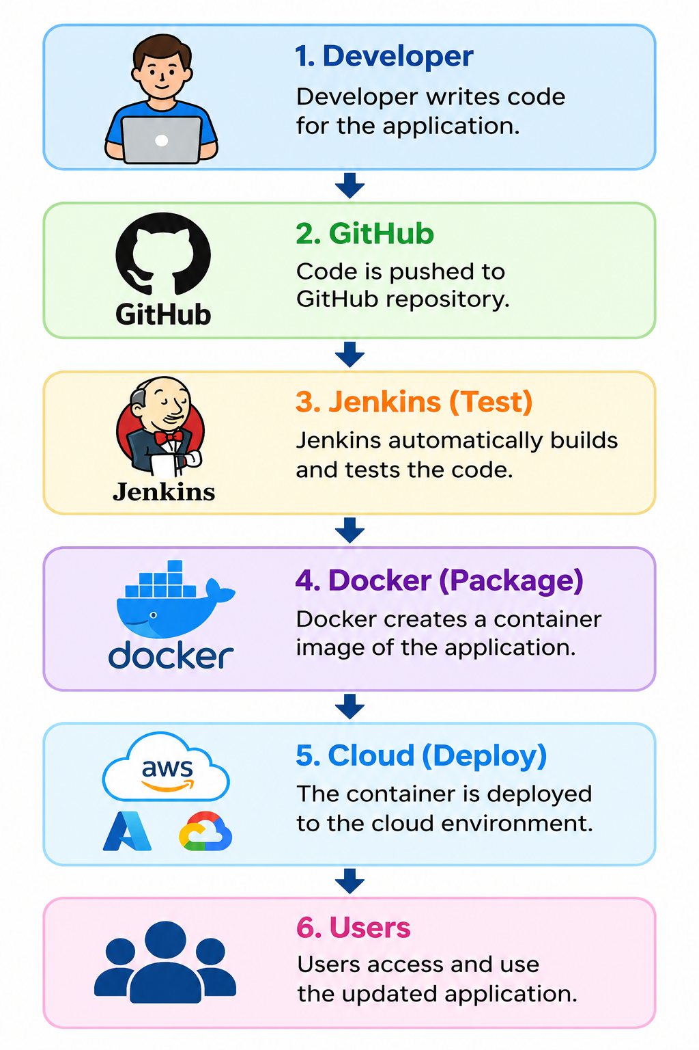
ARCHITECTURE

Slide 4
APPLICATION
Netflix
Amazon
Google
Banks
Mobile Apps

Slide 5
CONCLUSION
DevOps and CI/CD make software development faster, easier, and more reliable. They improve teamwork, reduce errors, and help companies deliver better applications quickly. Cloud computing allows users to access these applications anytime and from anywhere.

Slide 6


Slide 7
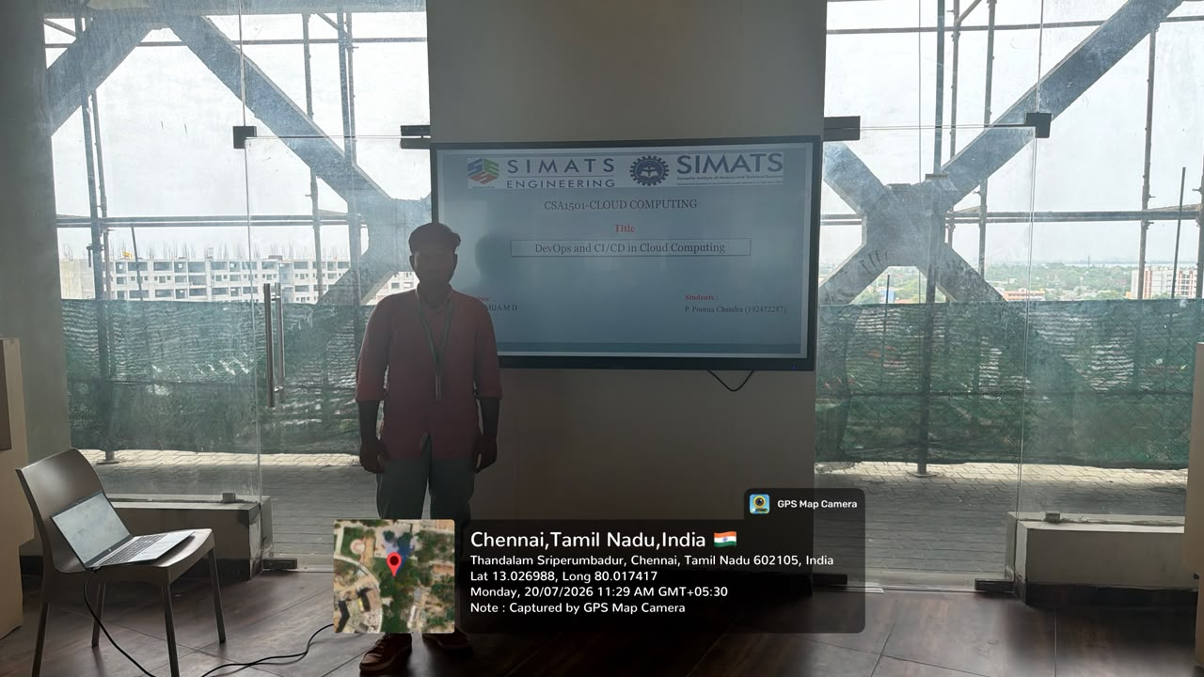
GEO TAG

